Slide 1

STUDENT INDUSTRIAL WORK EXPERIENCE SCHEME PRESENTATION CONDUCTED AT ZACRAC INTEGRATED LIMITED
By
Oghenekaro Emmanuella
FSC/CSC/01801029

Slide 2
Presentation Outline🚀
Introduction
Experience Acquired During SIWES
Project Executed
Challenges
Recommendation
Conclusion

Slide 3
Introduction

Slide 4
Introduction
01
02
Areas Assigned During Training
About Zacrac
Organization Structure
03
04
Training Services Provided

Slide 5
About Zacrac
Zacrac was established by Engr. Adewale Adeyemo in September 2016
Zacrac started as the core in Market research and public opinion pool helping organizations conduct surveys, research their market and give feasibility studies, overall focused was on data collection.
Zacrac offers training and developing solutions to individuals in the society in both data science and web development

Slide 6



Areas assigned during training
Data Science
UI and UX
Web Development

Slide 7
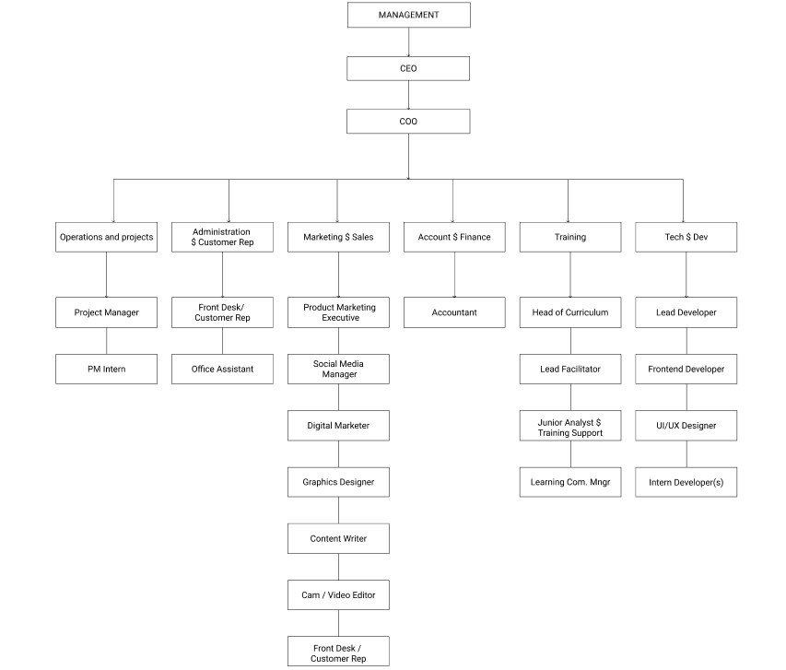
Organization Structure

Slide 8
Training Services Provided
Data Science
Here are the technologies taught:
Anaconda which includes all other python libraries that were taught like:
numpy
Pandas
Matplot
seaborn

Slide 9
Training Services Provided
Web Development
Technologies taught includes:
Html, CSS, JavaScript
CSS Frameworks(Tailwind CSS)
JavaScript Frameworks
Vue Js
React Js
UI and UX
The software that was used was:
Figma

Slide 10
Experience acquired during SIWES

Slide 11
Experience Acquired
Technologies
Online Platforms
Html, CSS and JavaScript
JavaScript Framework/ Library
(Vue js and React js)
Slack, Notion,
I also learnt how to use stackoverflow
Softwares
Data Science
Figma
Anaconda
Vscode
I was taught the basics of excel and python(some libraries) in relations to data science.
Package Managers
Working with version control systems
NPM
Yarn
pip
I learnt how to use git, github and
gitbash(hosting environment)

Slide 12
Project Executed

Slide 13

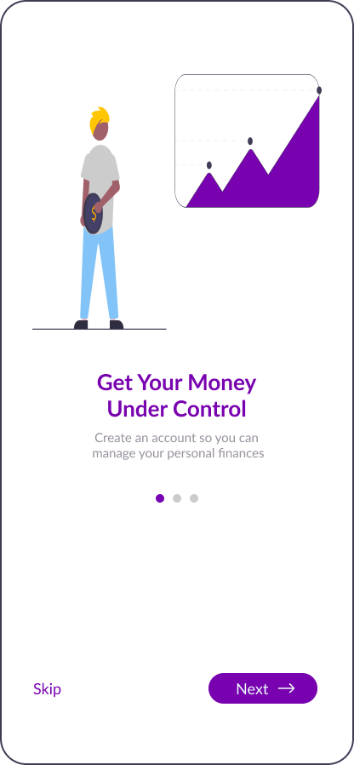

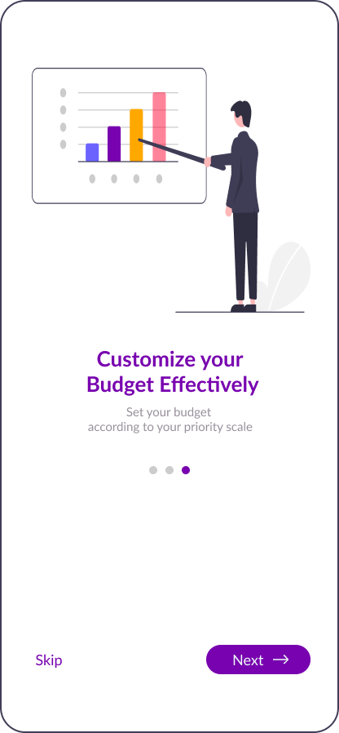
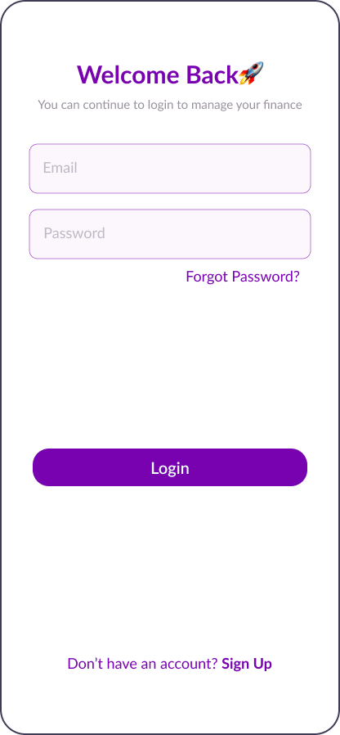
Project 1
UI design of a financial management app
Financial Management application, helps individuals saves their money rather than allowing users squander their money. This UI was designed using figma.
Fig 3.1: Splash Screen 1 Fig 3.2: Splash Screen 2 Fig 3.3: Splash Screen 3 Fig 3.4: Splash screen 4 Fig 3.5: Login Page

Slide 14
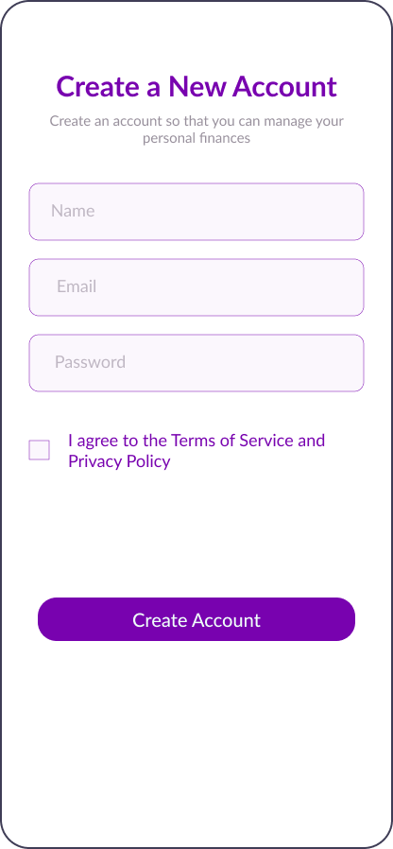
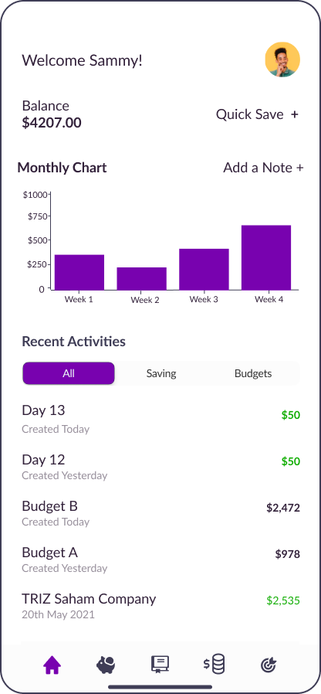
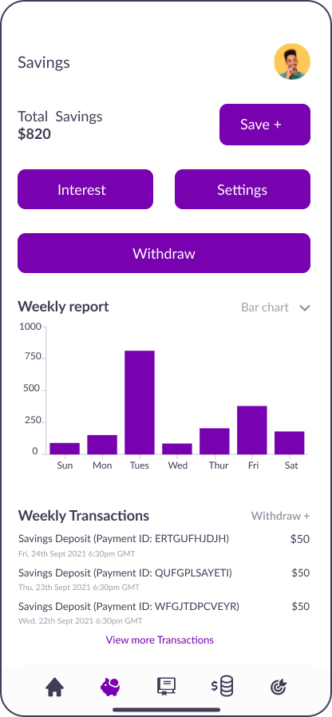
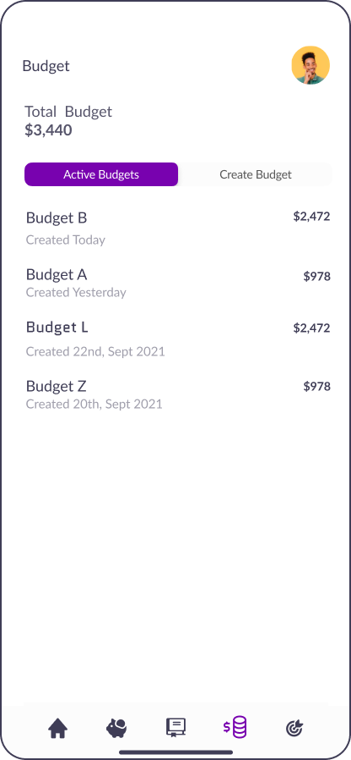
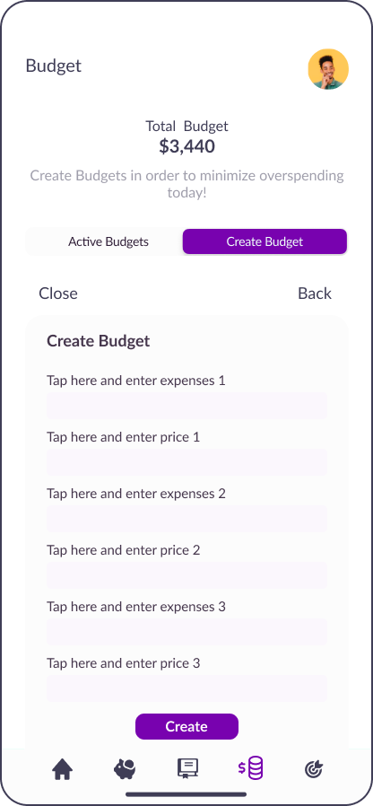
Fig 3.6: Sign Up Page Fig 3.7: Home Screen Fig 3.8: Savings Page Fig 3.9: Active Budget Page Fig 3.10: Create Budget

Slide 15
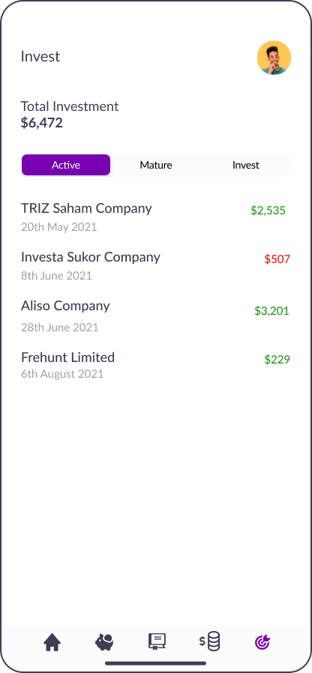
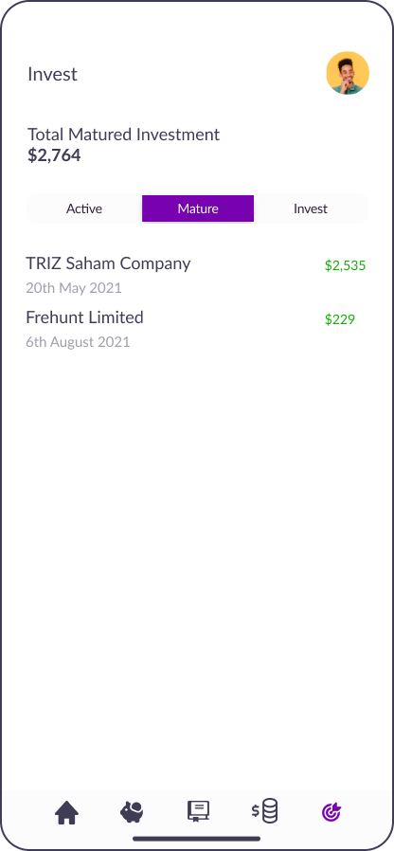
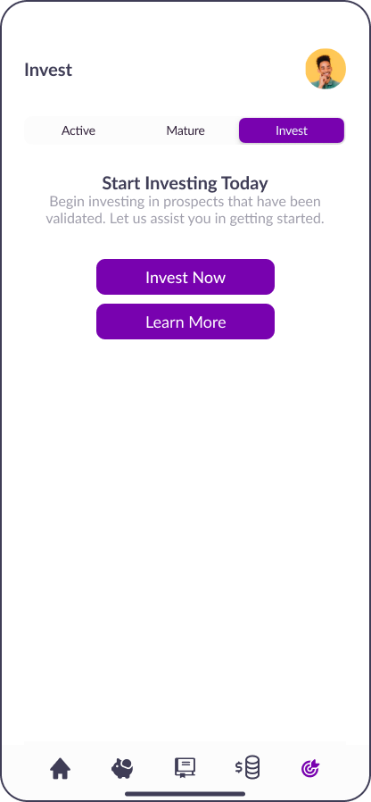
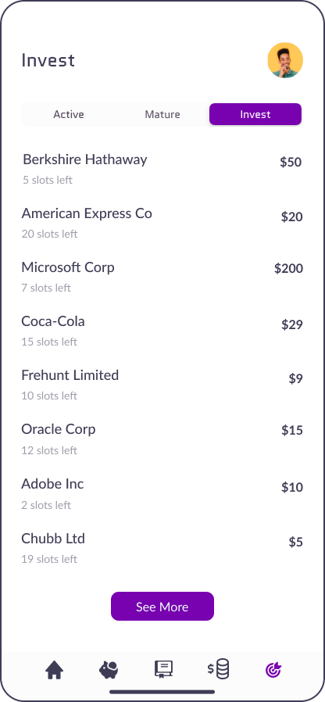
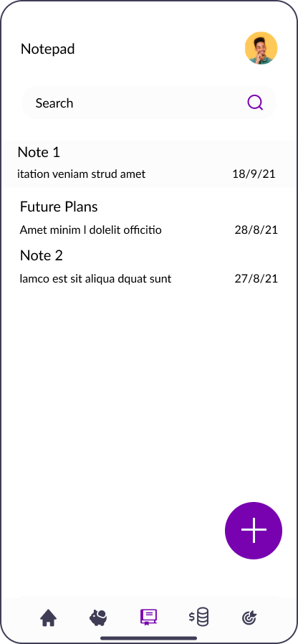
Fig 3.11: Active Investment Fig 3.12: Matured Investment Fig 3.13: Invest Fig 3.14: List of Investment Fig 3.15: Notepad

Slide 16
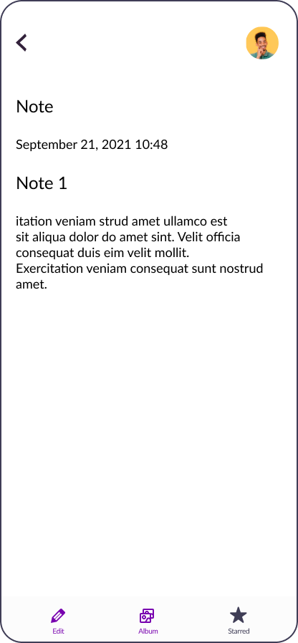
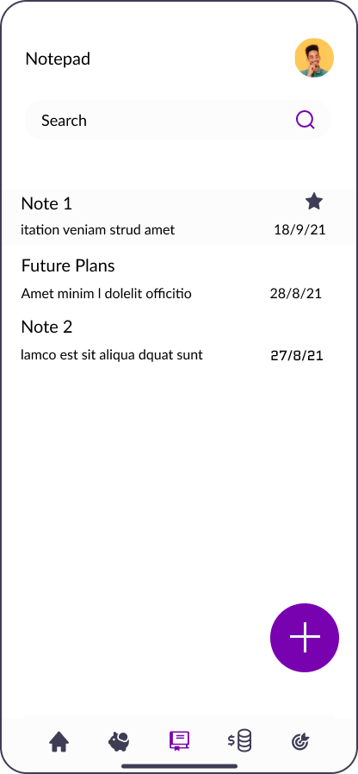
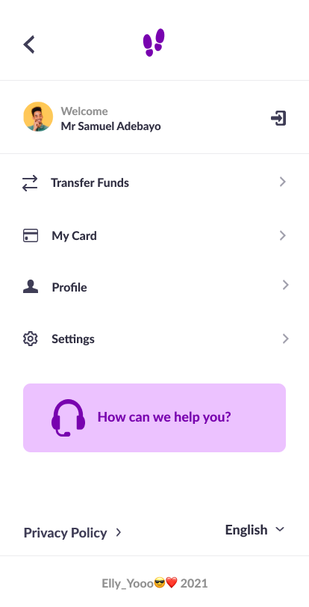
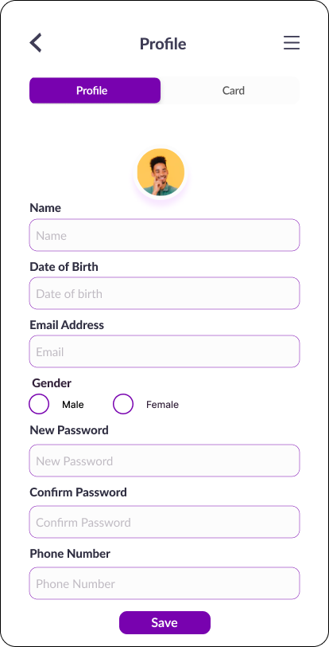
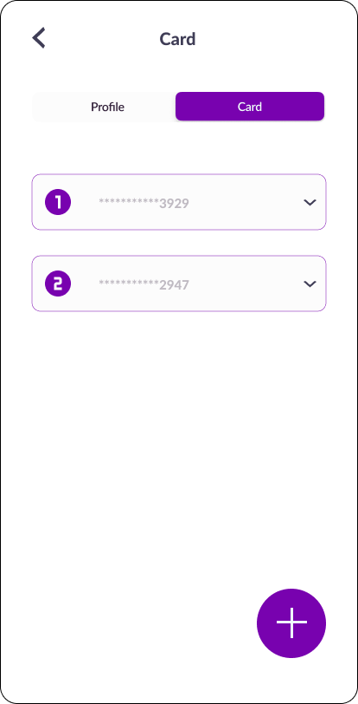
Fig 3.16: Other parts of the notepad Fig 3.17: Profile and Card Page
More of these pages are on the figma file!
https://www.figma.com/file/TzJVYB1e87aT2RQ9CJZRig/Milestone2?node-id=30%3A123

Slide 17

Project 2
A landing page for a car company (UI Design)
Figma Link: https://www.figma.com/file/UTI1rHZoZDx5nXb7RKXol3/design-2?node-id=0%3A1

Slide 18

Project 3
A landing page that attracts parents to enroll their kids in a high school (UI Design)
Figma link: https://www.figma.com/file/xzIZtbjCs1rxLQaSOX9EPR/HNG-Task-1?node-id=5%3A29

Slide 19
Project 4
A team project where we had to redesign the UI of slack’s dm for a company (Zuri organization)
Figma Link: https://www.figma.com/file/9h1CwL2iAwKHWwdffW71Lo/Zuri?node-id=0%3A1
I designed some slack’s DM (Direct Message) features like:
Add Reaction
Add more actions
All direct messages
Search DM
Search Messages
Search Messages in a DM

Slide 20
Pin Messages
View Pinned Messages
Un-pinned Messages
Remove pinned Messages Modal

Slide 21
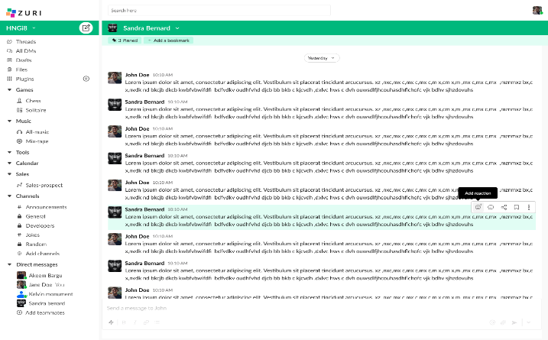
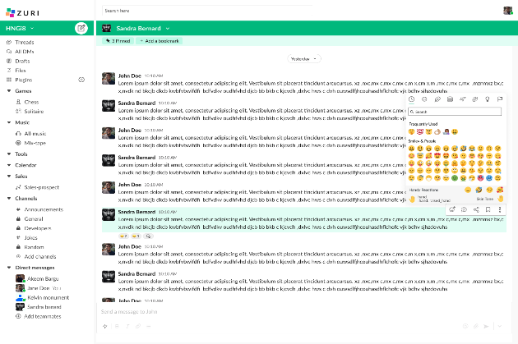
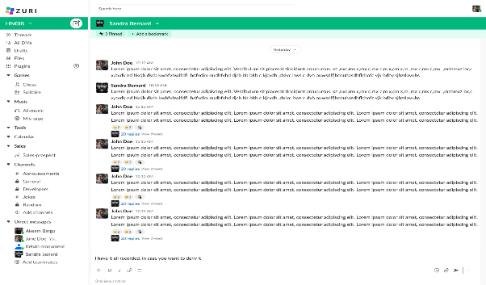
(a)
(b) (c)
Fig 3.20 (a) When you hover on a message, a menu pops up, click it. (b) It shows you list of emojis you can add as reaction (c) adds reaction

Slide 22
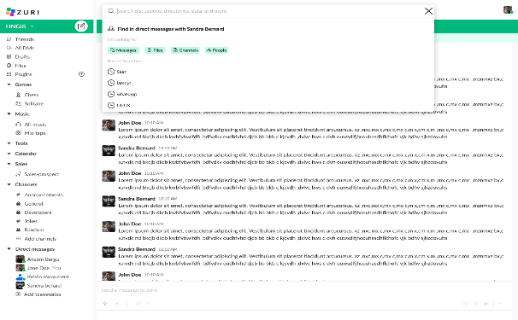
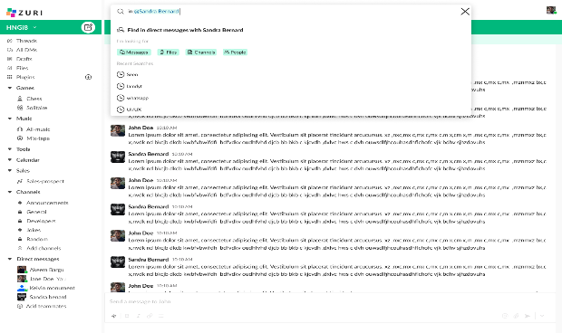
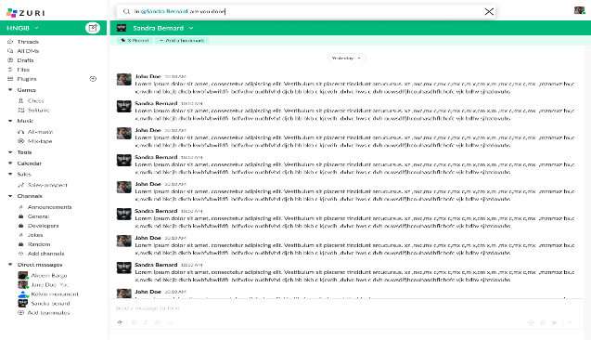
(a)
(b) (c)
Fig 3.21: (a) When you click on the search button at the top bar, a menu pops up, click it. (b) search the desired message and wait for it to load. (c) shows the filtered message based on what was searched.

Slide 23
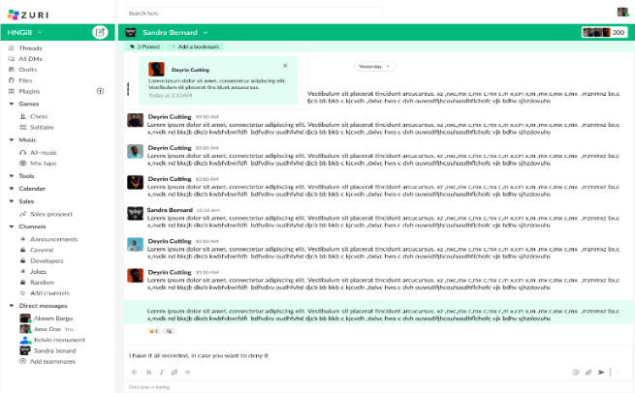
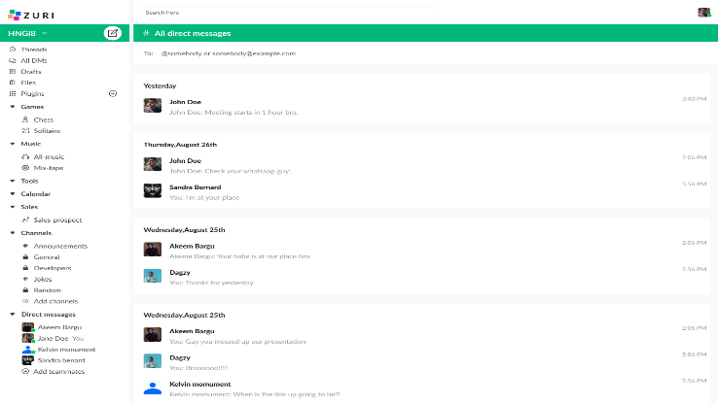
Fig 3.22: Tap on the pinned button, it shows the pinned messages
Fig 3.23: All Direct Messages

Slide 24
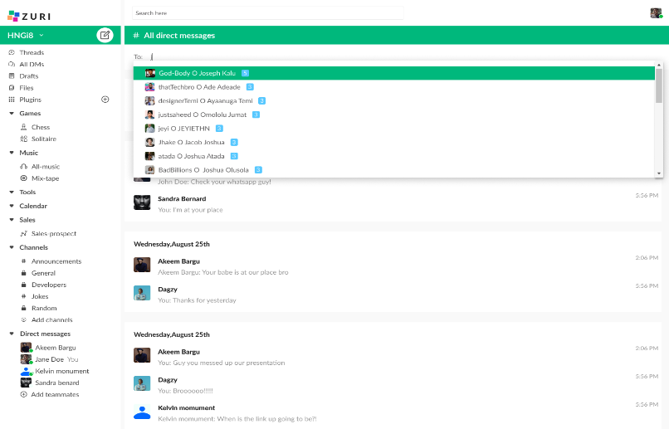
Fig 3.24: DM Search

Slide 25
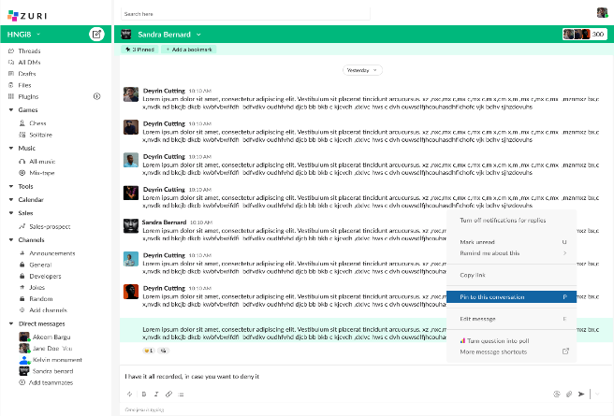
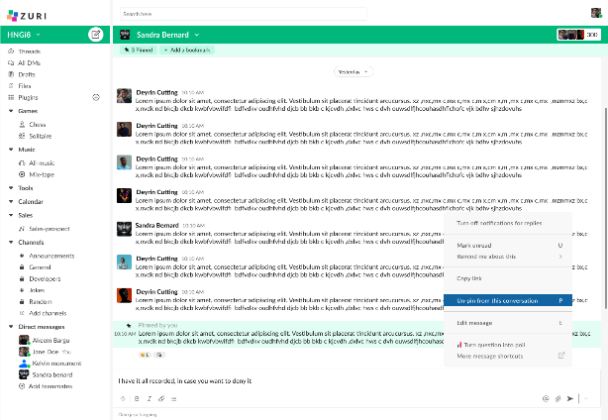
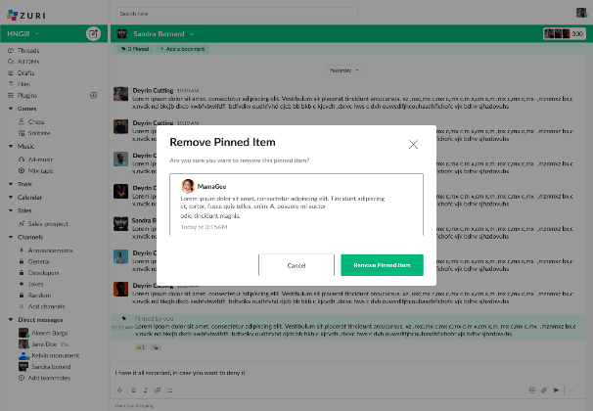
(a)
(b) (c)
Fig 3.25: (a) When you hover on a message, a menu pops up, click on the pin to conversation. It pins the message. (b) It shows you the message that has already been pinned and the dialog to unpin it. (c) After clicking on the button from image b, a dialog pops up to remove pinned item.

Slide 26
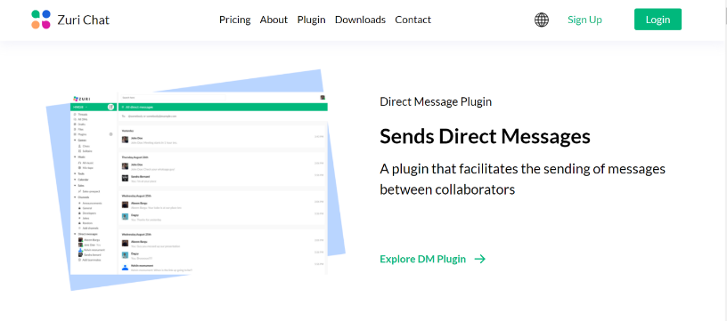
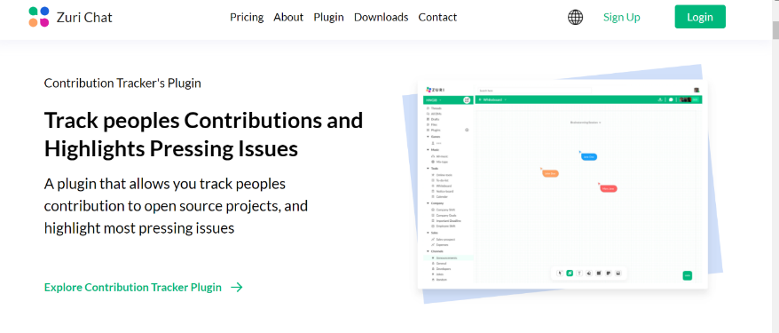
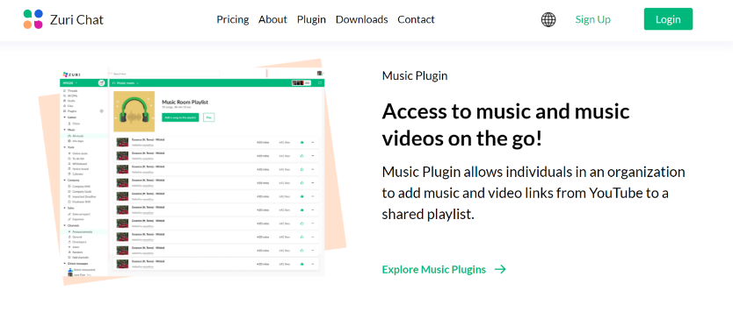
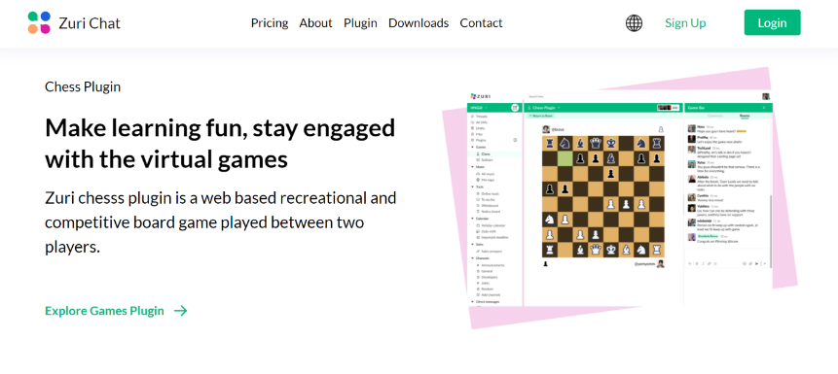
Project 5
An individual project where I had to create a page that explains all plugins created by the organization using React Js (Zuri organization)

Slide 27
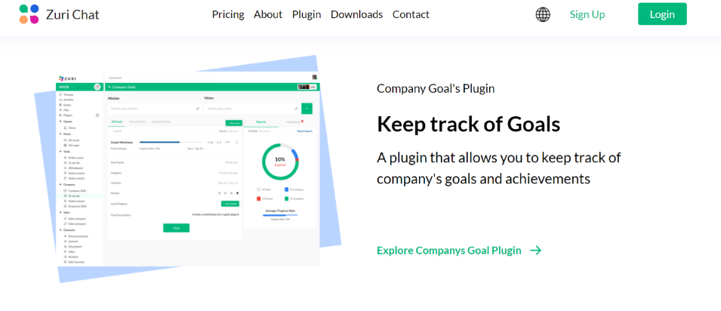
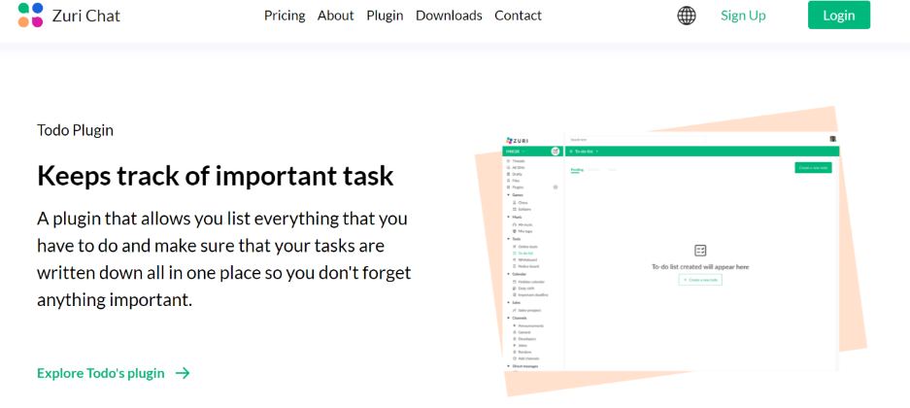
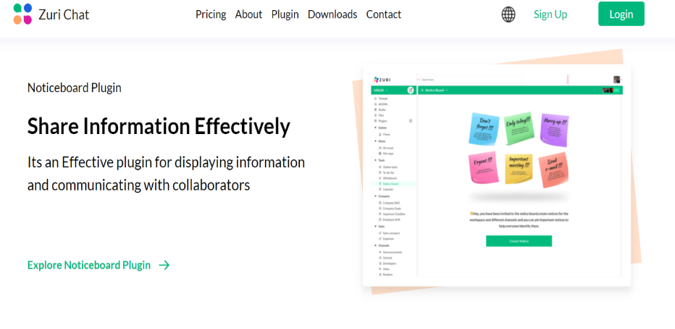
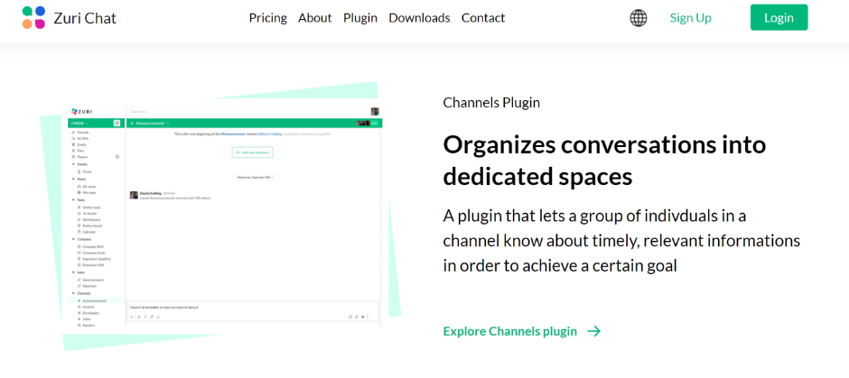

Slide 28
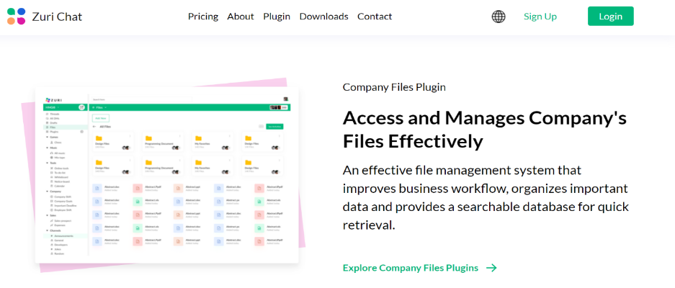
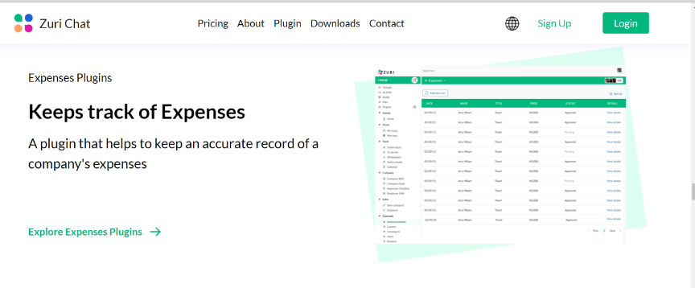
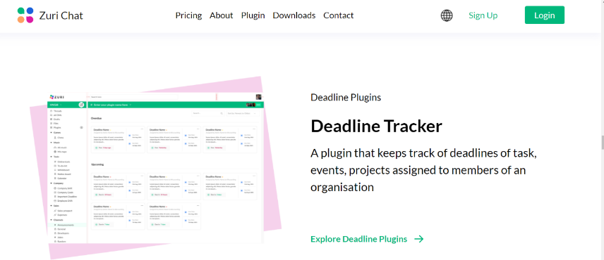
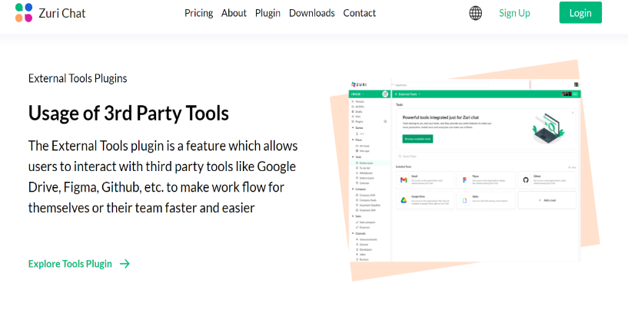

Slide 29
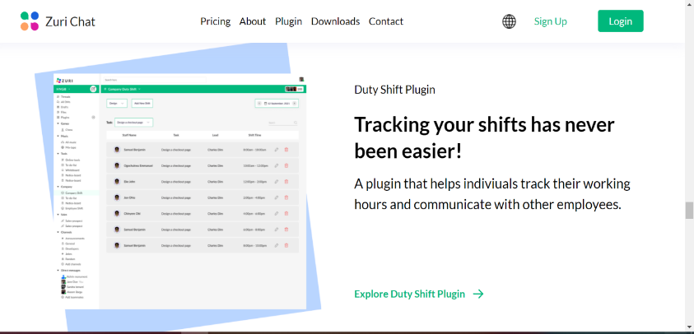
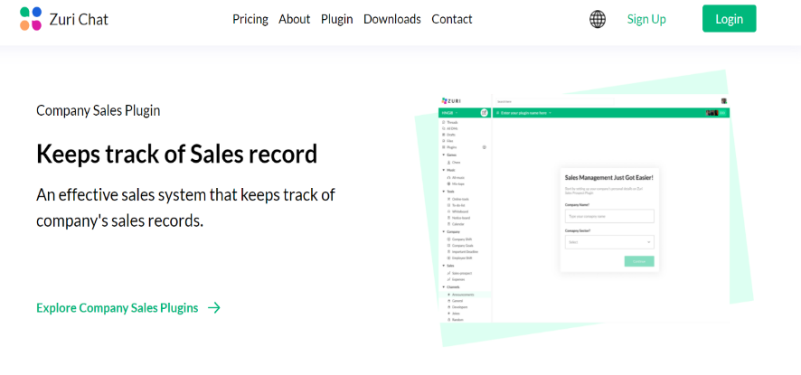
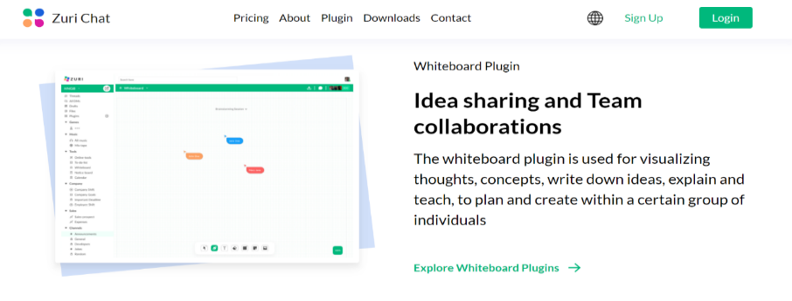
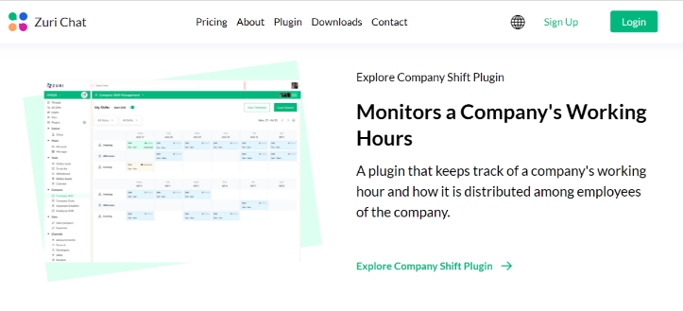
Fig 3.26: List of Plugins

Slide 30
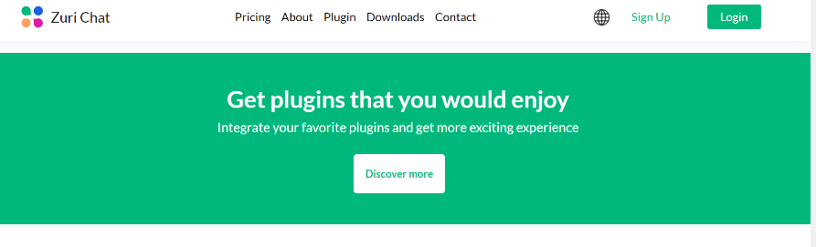
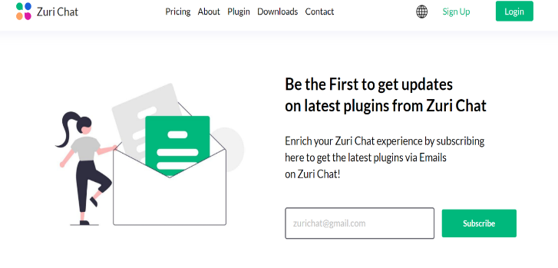
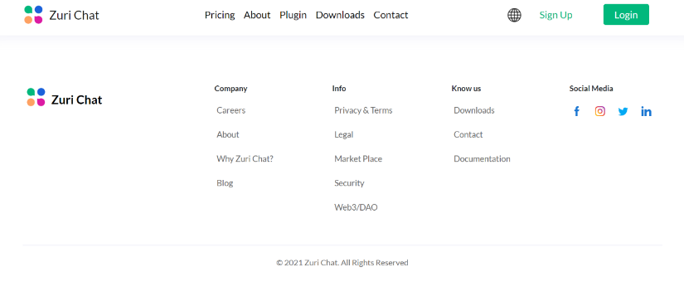
Fig 3.27: Subscribe for latest updates Fig 3:28: Footer
Pull Request link: https://github.com/zurichat/zc_main/pull/1851

Slide 31

Project 6
A team’s project where I and my teammates had to build a website for a company using the figma design created by the designer’s using Vue Js (Zuri Organization)
The aim of the website was to track the total number of interns per year and get to know their current status.

Slide 32

Fig 3.29: Progress tracker website

Slide 33
LIVE LINK: https://zuriprogresstracker.netlify.app/
PULL REQUEST LINKS:
https://github.com/paisoncodes/zuri_team_progress_tracker/pull/9
https://github.com/paisoncodes/zuri_team_progress_tracker/pull/16
https://github.com/paisoncodes/zuri_team_progress_tracker/pull/65
https://github.com/paisoncodes/zuri_team_progress_tracker/pull/101
https://github.com/paisoncodes/zuri_team_progress_tracker/pull/111
to confirm if the subscribe functionality really works, you can check this endpoint that shows the list of subscribers of our newsletter.
https://zuri-progress-tracker.herokuapp.com/api/v1/subscribers/

Slide 34
PROJECT 7
Redesigned Edo State University Uzuaire Website
I and my teammates created the UI design and implemented it using Figma. I and my teammates (Inu John and Fred Adeji) also coded it using html and Tailwind CSS
Link to repo: https://github.com/oghene-ella/Edsu-website/
Figma link: https://www.figma.com/file/qltlDNpjRSt1ZyMg1Hk887/Edsu-Revamp?node-id=0%3A1

Slide 35



Fig 3.30: Home Page Fig 3.31: About Us Page Fig 3.34: Activity Page

Slide 36



Fig 3.33: Programs Page Fig 3.34: Contact Us Page Fig 3.35: News Page

Slide 37
Project 8 Impact of Technological development on Youths’ Academic Performance in Akure South Local Government Area (Data Science Project)

Slide 38
Overview
In this study, the researcher’s focus is to focus on the impact technological development on youths’ academic performance from which one can easily find both the positive and negative impact of technology. The progress of science and technology can improve academic and also be a reason for poor academic performance depending on how you use these technologies.

Slide 39
Statement of the Problem
This research is worth studying because, we are not aware of the impact of technological development on Youths academic performance in Akure South local government area especially in a state like Ondo State, there haven’t been much improvement based on technological development unlike Lagos, Abuja, etc. though, it has been in existence for a very long time.
We also want to be aware if the father or mother’s Education has any impact on the academic performance of youths in akure south local government area.

Slide 40
Scope of Study
The study was restricted to youths (age 18-35) in Akure south local government area because of the aim of the research. This project will also cover youth of both gender (male and female) in Akure South local government area, Ondo state.

Slide 41
Objective of the study
As a result of the problems identified above, this study has identified the following objectives:
To discover the percentage of Youth’s that have obtained better education and that its reflecting on their academic performance due to the benefits that Technological Development has brought to them in Nigeria.

Slide 42
Research Question
In What Ways Has the Technological development made an impact on the academic performance among Nigerian Youths in Akure South Local Government?
Is it possible that the father and mother Education tells a lot about the child’s performance?

Slide 43
RESEARCH DESIGN
This study is to determine the impact of technological development on youths’ academic performance. Under this design, the questionnaires created were based on the research questions to discover the impact of technological development on youths academic performance.

Slide 44
RESEARCH HYPOTHESIS
H0:
There is no significant relationship between academic performance of the youth irrespective of having technology and mother’s education of the youth in Akure South Local Government
There is no significant relationship between academic performance of the youth irrespective of having technology and father’s education of the youth in Akure South Local Government

Slide 45
There is no significant relationship between academic performance of the youth and time spent on technological devices/ internet in Akure South Local Government
H1:
There is a significant relationship between academic performance of the youth irrespective of having technology and mother’s education of the youth in Akure South Local Government

Slide 46
There is a significant relationship between academic performance of the youth irrespective of having technology and father’s education of the youth in Akure South Local Government
There is a significant relationship between academic performance of the youth and time spent on technological devices/ internet in Akure South Local Government

Slide 47
Population/Sample Frame The sample frame for this study comprised of the youths at Akure south local government area

Slide 48

Sample Size
A sample of 385 youths were selected through simple random sampling technique and Interview. Using the formula for unknown population:
n = $\frac{({z)}^{2}}{4({m)}^{2}}$
where:
n = Number of sample size that are meant to be used
m = Margin of error (margin error of 5%)
z = z-score (95% confidence interval)

Slide 49

n =? , m = 0.05 , Z = 1.96
n = $\frac{({1.96)}^{2}}{4({0.05)}^{2}}$ = 384.16 ≈ 385

Slide 50
Data Collection Procedures
This researcher administered online questionnaire to the participants (Youths) via social media platforms after telling them the purpose of the exercise and assuring them that information volunteered by them would be treated as strictly confidential and used for the purpose of this research only.

Slide 51
Procedures for the Analysis
Step 1: I imported all necessary libraries for this analysis
Step 2: I declared a variable that will have access to my dataset
Step 3: I displayed the dataset and checked for the shape of the dataset
Step 4: I renamed all the columns to a suitable name and displayed it
Step 5: I addressed the missing values by calculating the total number of missing values.

Slide 52
Step 6: I captured all the missing values and worked on some using the mode method.
Step 7: I worked on the missing value for CGPA using mice. Then I merged all the columns that had missing values with the ones that had no missing value.
Step 8: I plotted some graphs using seaborn based on my Objectives.
Step 9: I converted my dataset from categorical data set to numerical except the cgpa column using get_dummies method. Converted it into 0’s and 1’s.

Slide 53
Step 10: I trained the model where I had 2 variables, X1 and Y1. Where X1 had majority of the dataset and Y1 had the cgpa column. I made use of OLS to describe the relationship between variables from my dataset
Step 11: The final result in fig3.36 shows that, the R-squared and Adj. R-Squared = 1.00 which means, the model perfectly predicts values

Slide 54

Fig 3.36: The Result of the Modelling

Slide 55

Fig 3.37: Cgpa across all genders
Notes:
The result of the analysis in figure 3.37 above showed majority of the respondents had 2nd class upper. Followed by the respondents that had 2nd class lower. Followed by the respondent’s that had 1st class. Lastly, based on the graph, it showed that a least set of respondents failed.

Slide 56

Fig 3.38: Mother Education
Notes:
The result of the Analysis in figure 3.38 above showed majority of the respondents mothers had a BSc degree.

Slide 57

Fig 3.39: Father Education
Notes:
The result of the Analysis in figure 3.39 above showed majority of the respondents fathers had Master’s degree.

Slide 58

Fig 3.40: Gender
Notes:
The result of the Analysis in figure 3.40 above showed majority of the respondents are Male respondents.

Slide 59

Fig 3.41: Comparison of gender grades
Notes:
The result of the Analysis in figure 3.41 above showed majority of the male respondents that had had better grades than the female gender.

Slide 60

Fig 3.42: Impact of social media platforms on respondents’ grades.
Notes:
The result of the Analysis in figure 3:42 above showed that social media platforms moderately improved respondents’ academic grades. Followed by the social media platforms that slightly improved their grades.

Slide 61

Fig 3.43: Impact of usage of search engines on the respondent’s academic performance
Notes:
The result of the Analysis in figure 3:43 above showed majority of the respondents that makes use of search engine, finds it extremely helpful in their academic performance.

Slide 62

Fig 3.44: Time spent on social media a day.
Notes:
The result of the Analysis in figure 3.44 above showed majority of the respondents spend time on social media are within the range of 1 – 3 hours. Followed by the respondents that spend time on social media platforms is within the range of 3 – 5 hours. Followed by the respondents that spend more than 6 hours. Lasted, fig 3.44 shows that there are no respondent’s that spends less than an hour on their social media

Slide 63
In conclusion, it shows that
There is a significant relationship between academic performance of the youth irrespective of having technology and mother’s education of the youth in fig 3.38
There is a significant relationship between academic performance of the youth irrespective of having technology and father’s education of the youth in fig 3.39
There is a significant relationship between academic performance of the youth and time spent on technological devices/ internet in fig 3.44, fig 3.43, fig 3.42

Slide 64
Challenges

Slide 65
Challenges
Anaconda setup issues
Network Issues
Laptop issues
Running into bugs

Slide 66
Recommendation

Slide 67
Recommendation I suggest the university cooperate with various institutions to facilitate placement and the academic environment that prepares students for real life industrial applications, so that students can work effectively in the industry.

Slide 68
Conclusion

Slide 69
Conclusion In conclusion, There were many challenges and the entire training period was a great experience. I learned a lot from Zacrac during my IT training

Slide 70
Thank you🚀❤

